Slide 1
Trip Troop
Your Journey
Our Mission!
Presented By:
Farwa Rashid (45945)
BSCS - 5 Semester

Slide 2
Agenda
Introduction
Project Architecture
Features
System Flow
Benefits
Conclusion

Slide 3

Introduction
This project is a Travel Management System that simplifies booking and managing trips through a user-friendly command-line interface. Simplify the process of booking trips, offering easy-to-use interfaces for users and admins.
Technologies Used:
Shell Scripting (Bash)
File Handling (Text Files for storing data)
Basic User Interface in Command Line

Slide 4


Project Architecture
User Side:
Register & Login: Users can create accounts and securely log in.
Book Trips & Cancel Bookings: Users can plan their trips by booking or canceling as needed.
View Destinations: Browse through a list of available destinations with details like prices.
Admin Side:
Manage Destinations: Add, update, or remove travel destinations and pricing.
View Booked Trips: Monitor all trips booked by users for better organization.
Generate Reports: Create summaries of bookings and revenue for analysis

Slide 5



Features
User Side:
User Registration: Users can create an account.
Login System: Secure login for accessing booking features.
Booking a Trip: Select destinations, provide required information and confirm bookings.
Cancel Booking: Users can cancel their trip bookings if needed.
View Available Destinations: Users can see a list of travel destinations and prices.
onses

Slide 6
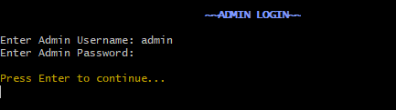
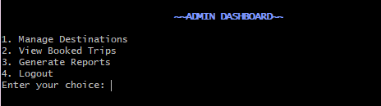
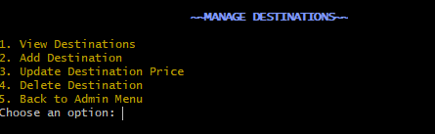
Features
Admin Side:
Admin Login: Secure login for admins.
Manage Destinations: Add, update, and delete destinations.
View Booked Trips: Admins can see all users’ bookings.
Generate Reports: Admins can generate reports showing booking statistics and total revenue.
onses

Slide 7
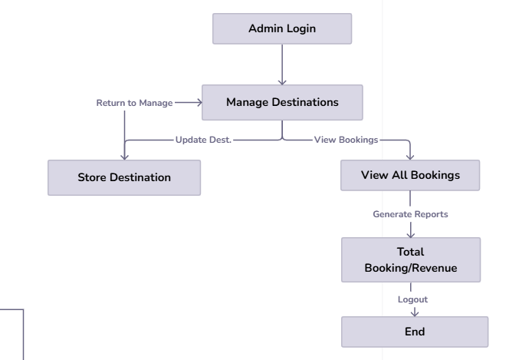
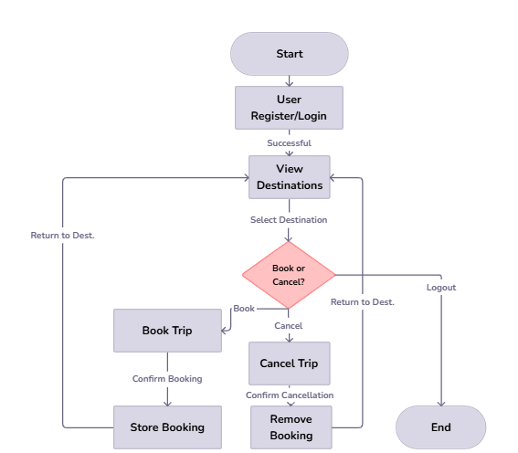
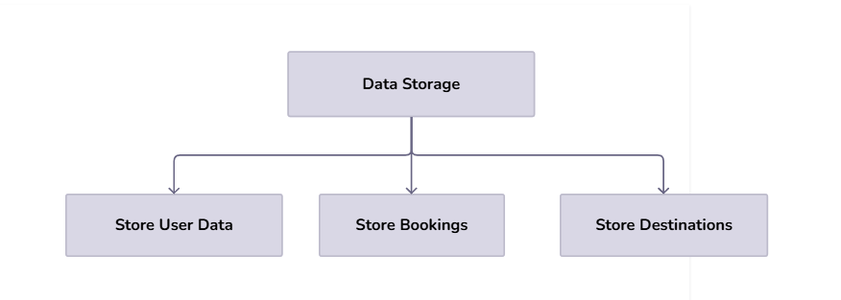
System Flow

Slide 8
Benefits of This System
Simplifies the entire process of booking, managing, and canceling trips, making it more efficient for all users.
The ability to generate reports on bookings and revenue enables timely decision-making and performance tracking
The system’s use of simple text files for data storage reduces overhead costs compared to using more complex database system
The simple command-line interface allows for an intuitive and easy experience without requiring advanced technical knowledge.
Easily expandable to include more destinations, users, or features without significant redesign.

Slide 9
Conclusion
The trip management system simplifies travel planning with a user-friendly platform for bookings and streamlined admin operations. It enhances efficiency, scalability, and user satisfaction while setting a foundation for future advancements, showcasing the power of automation in modern travel management. This system is a testament to the transformative potential of automation, offering a sustainable, time-saving, and highly effective solution for modern travel management.

Slide 10
Thank you

